Slide 1
Understanding and Utilizing Your NACEP Membership
Miranda Rodriguez
Director of Communications and Member Services

Slide 2
Types of Memberships
Organizational Membership
  Each membership is tied to an organization
  Each organizational membership is made up of sub members (YOU)!
  To vote, renew membership, and add sub-members you must be signed into this organizational account. Sub member accounts will not work.
  Each organizational account has a primary contact.
Sub-Member Membership
  This is your individual membership
  Register for events, conferences, and webinars, see past webinars, find member-only resources

Slide 3
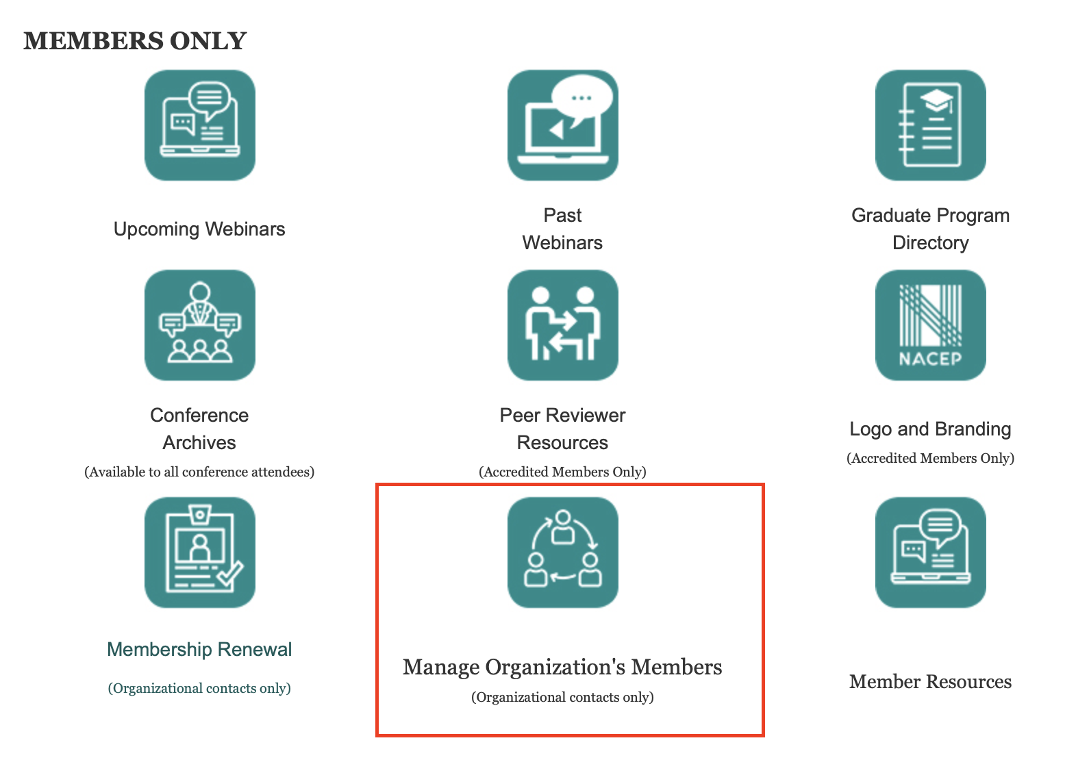
Managing Sub-Members & Renewing Membership
Sign into your Organizational Account using the organizations username and password
Scroll to the bottom and click on “Manage Organization’s Members”

Slide 4
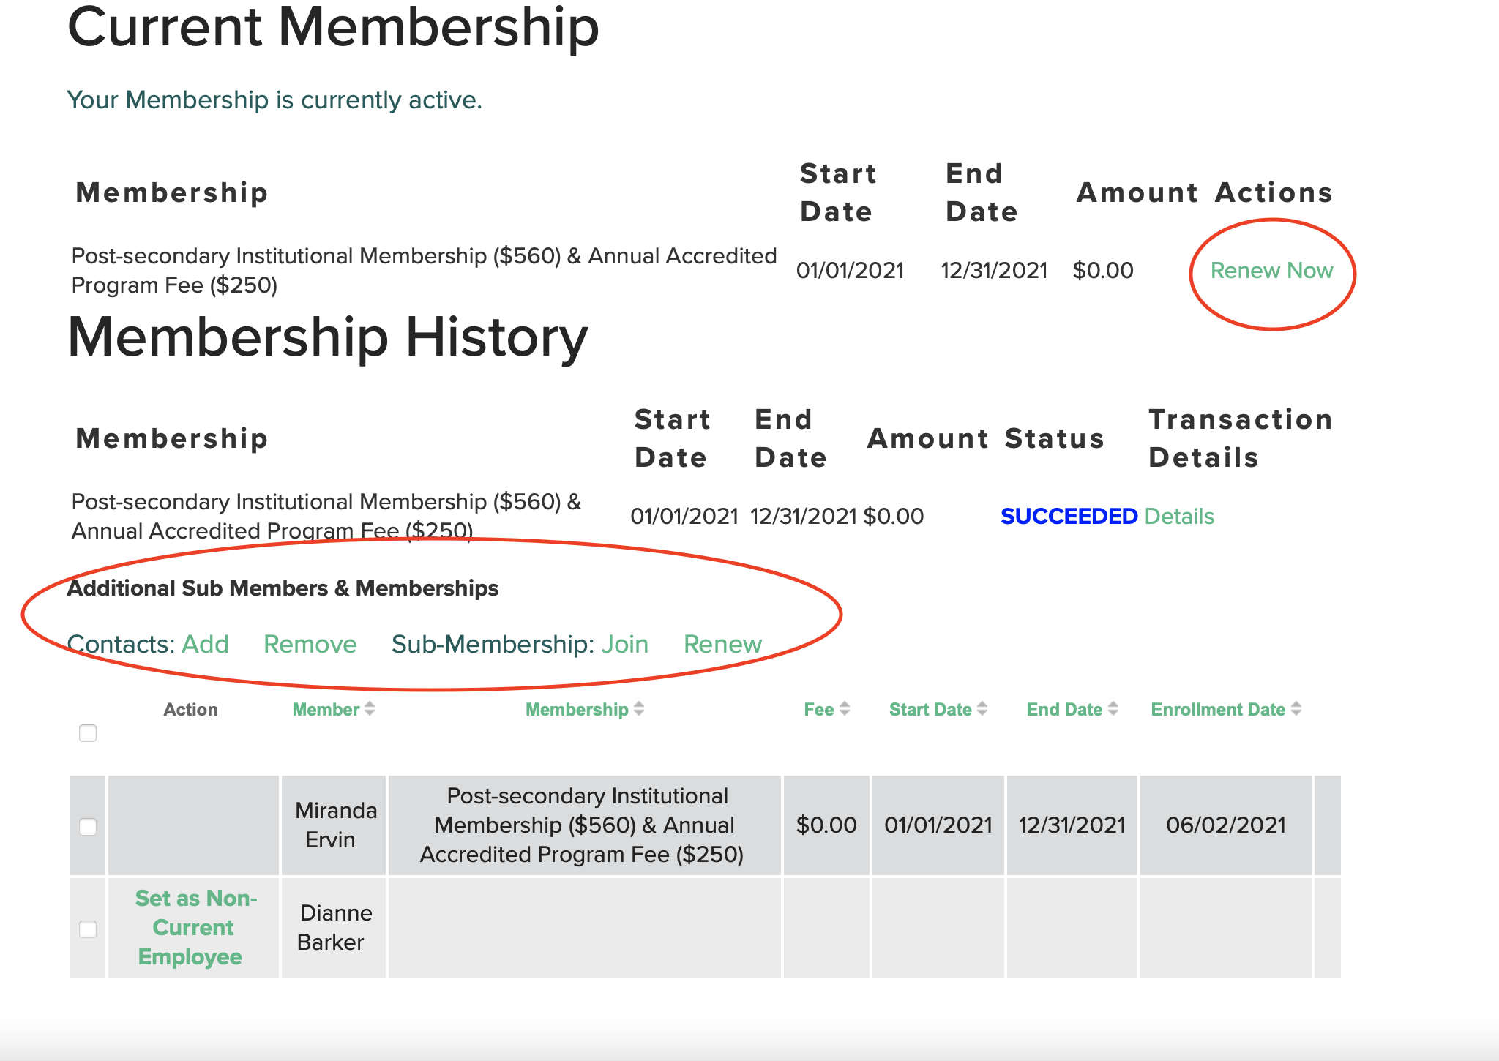
Managing Sub-Members & Renewing Membership
Renew membership above by clicking “Renew Now”
You will be prompted to add pay or pay later.
Add and remove sub members by clicking add or remove

Slide 5
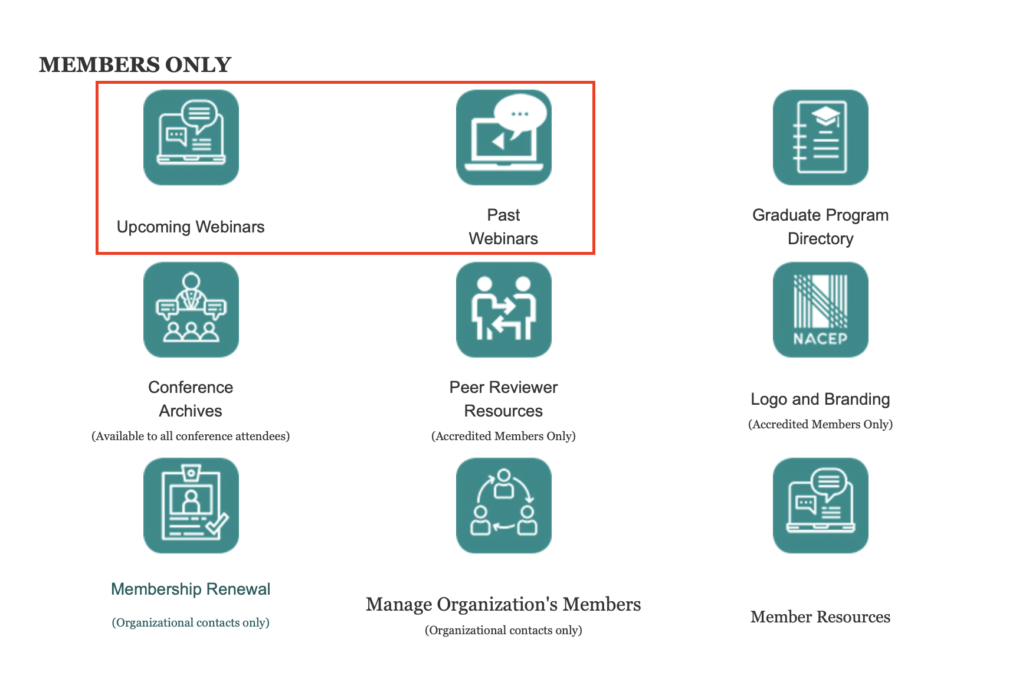
Accessing Upcoming and Past Webinars
Sign into your Individual Account
Find the menu items for “Upcoming and Past Webinars.”
Click and register or view.

Slide 6
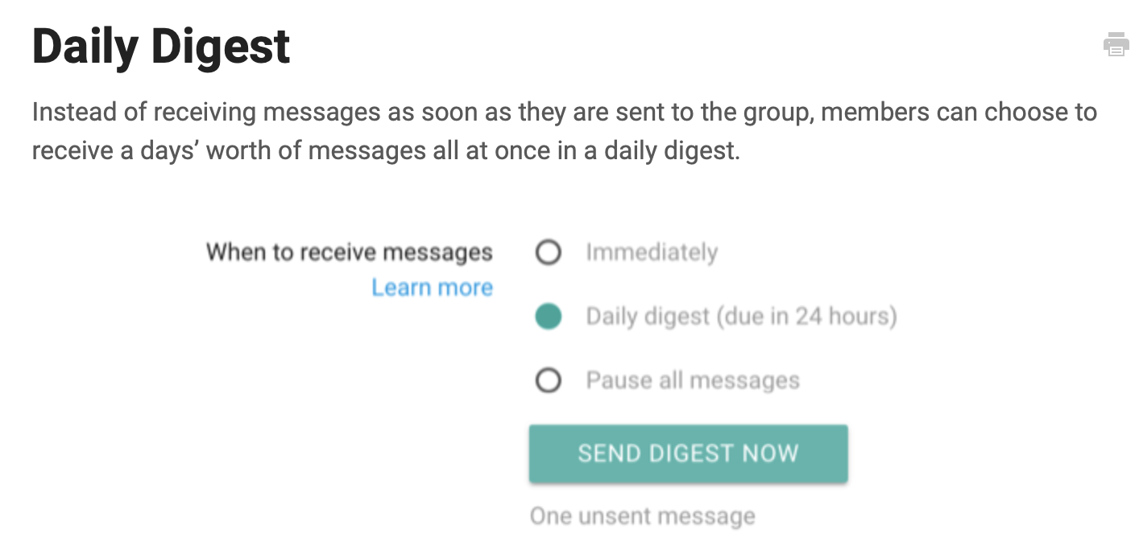
NACEP Listserv| Member-Only Resource
Use listserv to start discussions with colleagues across the country
Added once you become a member or renew membership
Choose whether you want immediate delivery or a daily digest
Email nacep-listserv@gaggle.email to add to the listserv discussion or to pose a question.

Slide 7
Got Questions?
Feel free to reach out to Miranda Rodriguez, mrodriguez@nacep.org

