Slide 1
Entering the Starting Gate for Credential Attainment
NACEP National Conference Preview
September 15, 2016
advancing quality college courses in high school

Slide 2
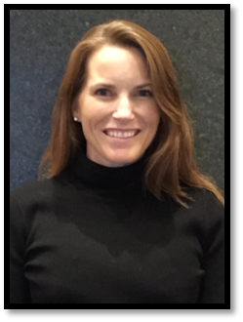
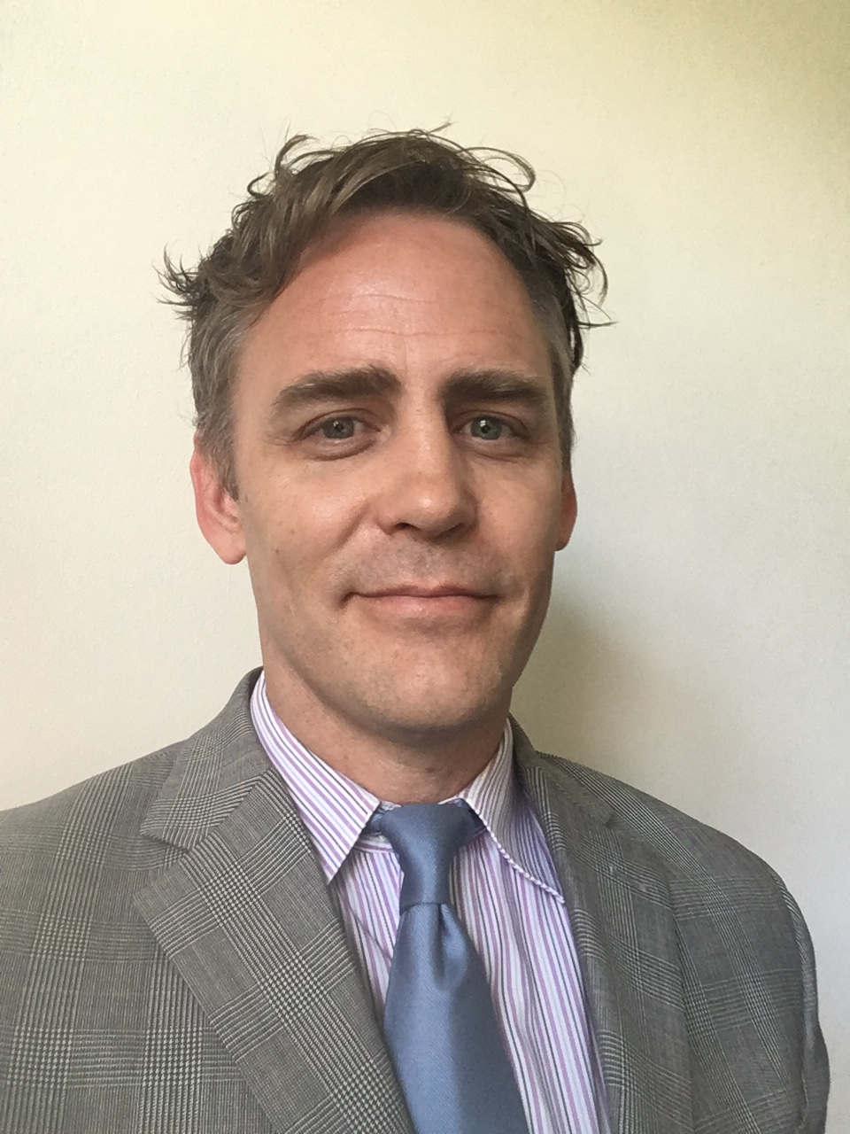
Presenters
Amy Williams, Montana University System
Amy is the Dual Enrollment & Big Sky Pathways Program Manager at the Montana University System’s Office of the Commissioner of Higher Education. In that role she works with state leaders and collaborates with dual enrollment coordinators from 11 community colleges and 4 tribal colleges across the state. Prior to working in dual enrollment, Williams was a national award winning secondary educator and STEM education consultant.
Curtis Biggs, Sussex County Community College (SCCC)
Curtis has spent over a decade in dual credit partnerships and policy, emphasizing investment in collaborative professional development and planning between secondary and postsecondary. He currently serves as Interim Dean of Student Affairs at SCCC. The College is rapidly expanding dual credit programming, including faculty development and credentialing expansion.

Slide 3
Dual Credit Credential Attainment
Challenges
Opportunities
Conference Sessions
Q & A (use the chat box)

Slide 4
Credentialing Challenges
Access
Requirements
Time and Timing
Funding

Slide 5
Credentialing Opportunities
Credential Review
Professional Development
Best & Enhanced Practice Sharing

Slide 6
Credentialing Solutions Sessions
Collaboration as the Key to Credentialing Success
Linda Knicely, Battelle for Kids (Ohio)
Tracey Nijera, Battelle for Kids (Ohio)
Educational Partnerships to Promote Dual Credit Access for Regional Students
Donna Ekal, The University of Texas at El Paso
Cyndi Giorgis, The University of Texas at El Paso
Big Idea Session on Credential Attainment
Michael Ginnetti, Bowling Green University (Ohio)
Robert Mitchell, Colorado Department of Higher Education

Slide 7
Q&A or Topics for Discussion
What are your district and partner needs?
What disciplines are you wishing to expand?
What actual or prospective funding mechanisms?

Slide 8
NACEP’s 2016 National Conference is Coming to Louisville!
The Triple Crown: Quality, Collaboration, and Transition
October 17-18, 2016 | Louisville Marriott Downtown
Pre-conference workshops October 16
Hosted by:

