Slide 1
Tackling Concurrent Enrollment
as a Small Program
Hosted by
Minnesota Concurrent Enrollment Partnerships (MnCEP)
September 20, 2016
advancing quality college courses in high school

Slide 2
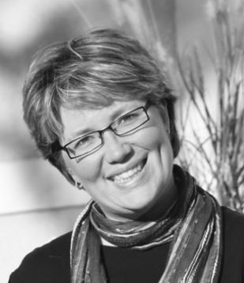
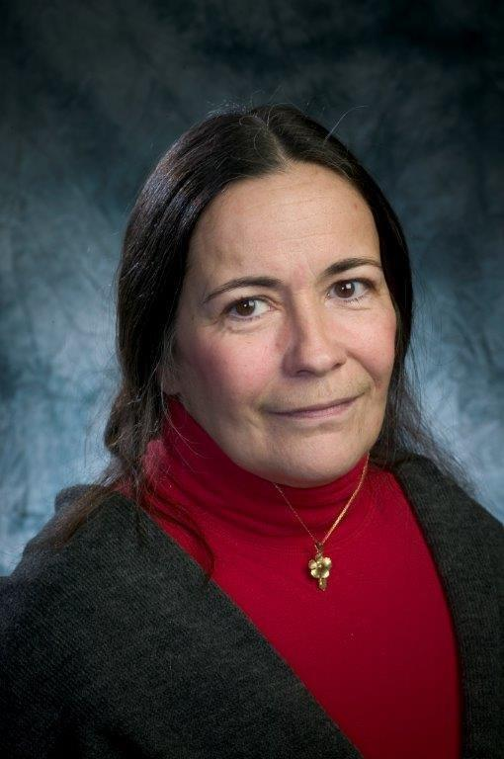
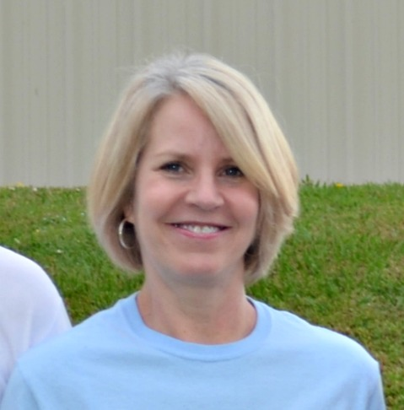
Presenters
Kelley McClure-Mork, Ridgewater College (MN)
She is the Special Projects Coordinator. She has been in various roles from Residence Life, New Student Orientation, Faculty, Academic Advising, and everything in between. She holds a Bachelors from the University of North Dakota and a Masters from Murray State University.
Kathleen Carr, Sussex County Community College (NJ)
Kathleen is the Assistant Director of Testing Services and Academic Outreach. She has been a member of the College Community for fifteen years and oversees many school initiatives. She also teaches Developmental English. She possesses a BA in English and a Masters Degree in Education Administration. CEP is a new initiative which she hopes to expand in the upcoming years.
Terri Colananni, College of the Ouachitas (AR)
Terri serves as the Concurrent Enrollment Coordinator since May 2014. She has a BSE and an MSE in mathematics and was hired to teach math in 1990. She led the College’s concurrent enrollment program from its inception in 1997 through 2004 which was prior to COTO’s NACEP affiliation.

Slide 3
Ridgewater College
About the Program
The numbers:
8 high schools
7 teachers (1 teacher works with 3 high schools)—we haven’t had a new HS teacher since 2014.
Subject areas include: Agriculture, Biology, English, Marketing & Sales Management, Nursing Assistant
High schools are throughout West Central Minnesota in rural districts
117 unduplicated headcount
Program started in 2006 offering one course—English Comp I
Accredited by NACEP in May 2013. At time of application: 3 teachers at 2 high schools.
.

Slide 4
Ridgewater College
Challenges
Small isn’t a challenge….a huge advantage.
Frustrations? Of course!
They’re the same challenges that other schools in the state of Minnesota face regardless of size and location.

Slide 5
Ridgewater College
Tips and Tricks
Being small allows you to have personable customer service to parents & high schools
Find a way to document/track other than a spread sheet
Implement the 17 standards for accreditation from day 1. Just because you’re small doesn’t mean you can’t be accredited.

Slide 6
Ridgewater College
How do we do…
Professional Development:
Joint professional development day that includes 1:1 time with their mentor for the discipline specific requirement.
Certificate of Participation
We do not provide stipends or mileage reimbursement, but we do offer lunch!
Training/Orientation
Two tier approach—part 1 is online, part 2 is with mentor
Registrations
I work with high schools to collect applications/transcripts/test scores
They send to me and I double check them before sending them over to registration.

Slide 7
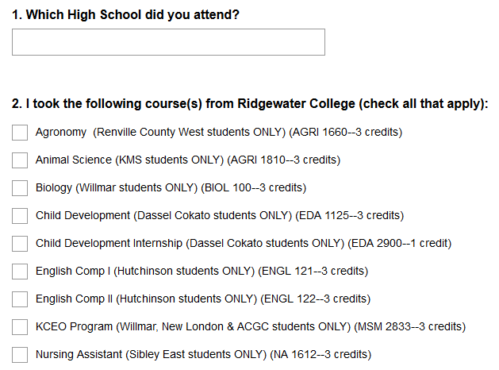
Ridgewater College
How do we do…
Evaluations:
Survey Monkey & Paper
Include their high school instructor on the letter
We tweak the survey, adding specific high school courses (screen shot below)
We don’t have an Office of Institutional Research anymore, so having it evaluated by someone other than me has been a challenge at our college.

Slide 8
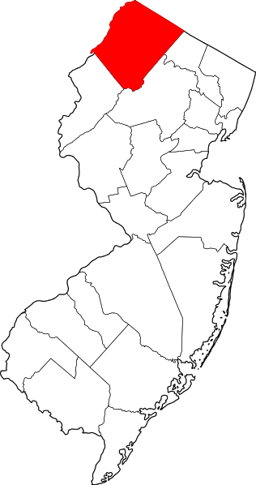
Sussex County Community College
Overview
Students
Our student population consists of Juniors and Seniors from the surrounding high schools
The numbers:
10 high schools
Approximately 400 students
58 instructors

Slide 9
Sussex County Community College
Changes and Challenges
Biggest Challenge:
Declining enrollment in the county’s high schools
Changes to meet challenges:
Good outreach practices and additional courses have increased enrollment numbers.
Additional courses such as Agriculture, Welding, Cosmetology and Automotive make our program more attractive to all students

Slide 10
Sussex County Community College
Tips

Slide 11
College of the Ouachitas
About Us…
Origin:
From 1997 to now…
The numbers:
7 High Schools
240 Students
12 CE Instructors
4 COTO Faculty Liaisons

Slide 12
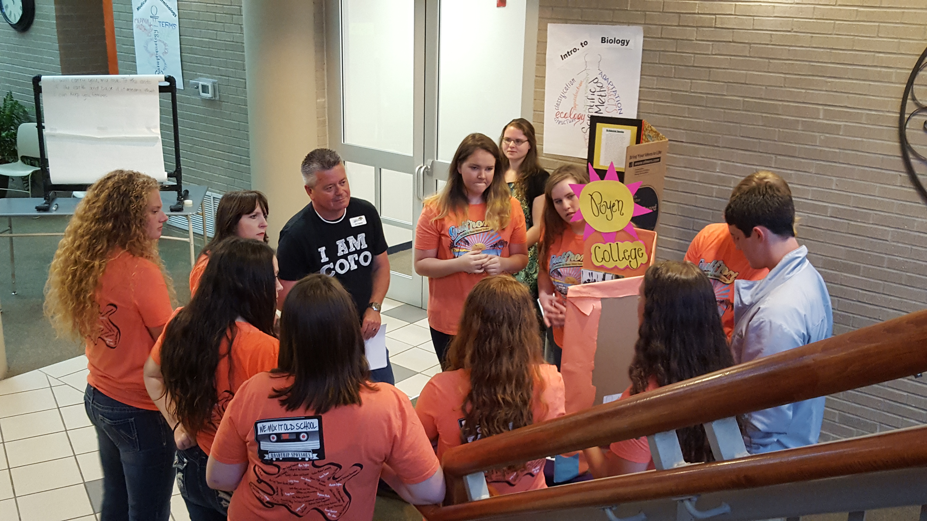
College of the Ouachitas
Students and Classes
Small, rural high schools with high-achieving and academic middle students. Most common classes are Composition I & II and College Algebra and Plane Trigonometry.
CE Students presenting at COTO’s 2016 Academic Showcase

Slide 13
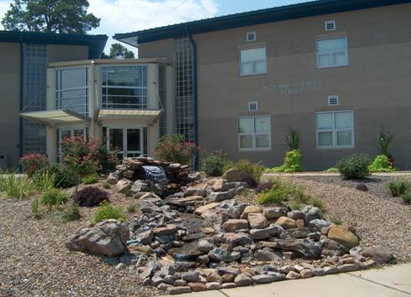
College of the Ouachitas
Suggestions
Keep your eye on the BIG Picture
Foster good working relationships with key constituencies
Develop an Action Plan and calendar
BUT, the devil is in the details…
Develop a system/checklist for all activities
Set up 17 folders (one for each standard – electronic or paper)

Slide 14
College of the Ouachitas
How we do it…
All of COTO’s high schools are within a 30-mile radius of the College.
Orientation – New CEP Instructors come to campus and meet with the CE Coordinator and their Faculty Liaison.
Professional Development – All CEP Instructors are expected to attend an annual dinner that includes a three hours discipline-specific breakout session. ($50 stipend)
Evaluations – Faculty Liaisons, who receive a small stipend to serve, conduct student evaluations during their site visits or the CE Coordinator does it.
Registration – Part-time Student Affairs Counselor travels to high schools for placement testing and registration as needed.

Slide 15
Future NACEP Events:
October 4th- Perkins in Practice:What is working (and not) in CTE-focused concurrent enrollment
October 16-18th- NACEP National Conference
November 29th: Standards 101 Webinar

