Slide 1
Becoming a NACEP State and Regional Chapter

Slide 2
The National Alliance of Concurrent Enrollment Partnerships (NACEP)
NACEP Board of Directors
NACEP Commissioners
NACEP Volunteers & Staff
A member-supported, member-serving national organization.
Our NACEP Board of Directors, Commissioners, volunteers, and staff all partner to take on the important work of advancing quality college courses for high school students nation-wide.

Slide 3
NACEP is the first and only national organization supporting
Programs
Practitioners
Policy
to advance quality concurrent enrollment, dual enrollment, dual credit, and early college programs.

Slide 4
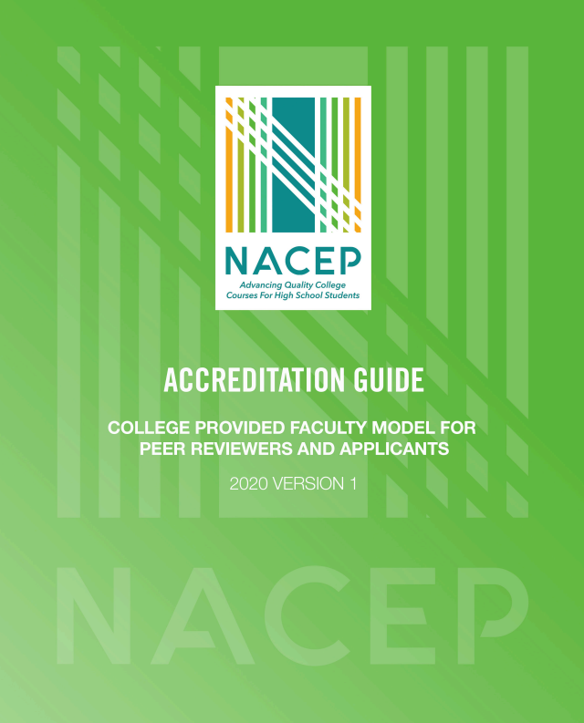
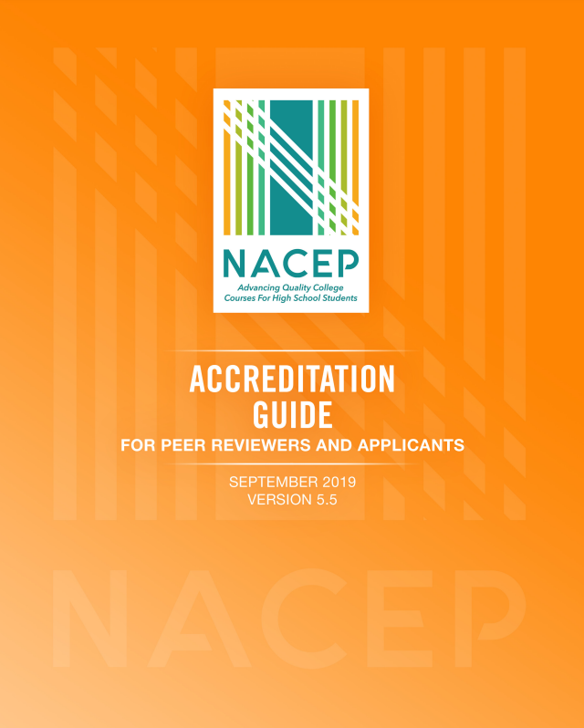
NACEP National Quality Program and Accreditation Standards
NACEP supports program quality by providing a framework of rigorous standards and affirming excellence through accreditation.
Concurrent Enrollment Model
College Provided Faculty Model
The standards are the basis for accreditation, but all programs can benefit by using the standards as a framework for program development and management.
119 programs, in 24 states, and 28 program are applying for this years accreditation cycle
25 states require, incentivize, or encourage NACEP accreditation or NACEP quality standards in legislation.
Notes:
National Standards of Quality Programming framework areas are in Partnership, Student Experience, Faculty Development, Curriculum and Assessment Parity and Program Evaluaion

Slide 5
NACEP Support Practioners
Annual National Conference
Regional Conferences
Policy Seminars
Topical Webinars
Accreditation Institutes
State Technical Assistance
Publications
Research
Reports
Federal & State Policy Advocacy

Slide 6
NACEP Supports Policy
Federal Legislation
Transition Memos
Direct outreach
State Legislatures
Policy resources
State policy framework
State & System Ed. Leadership (K12/Postsecondary)
Direct outreach and service
Advocacy Commission
State & Regional Chapter, Member Support
Model policy repository
State finance resources
Joint policy resources and publications
Information, resources, and connections
Leadership training
Direct engagement and service
Policy advocacy and support

Slide 7
NACEP State & Regional Chapters
State and Regional Chapters, is a great way to ensure the advancement of dual and concurrent enrollment issues important in your communities.
Many state and regional partnerships have successfully:
Leadership and professional development opportunities
Networking, research publications and shared resources
A united voice to advance equitable policy and legislation
Launch statewide publicity campaigns to benefit communities
Supported each other on program improvements and alignment with NACEP standards
Notes:
Current Chapters are Arkansas, Illinois, Minnesota, Michigan, New England, Ohio, Utah
Working on Chapter: Florida, Indiana, and Texas

Slide 8
Current NACEP State and Regional Chapters
Arkansas Alliance of Concurrent Enrollment Partnerships (AACEP)
Florida Alliance of Dual Enrollment Partnerships (FADEP)
Illinois Alliance of Concurrent Enrollment Partnerships (ILACEP)
Minnesota Concurrent Enrollment Partnerships (MnCEP)
Michigan Concurrent Enrollment Partnerships (MiCEP)
New England Alliance of Concurrent Enrollment Partnerships (NEACEP)
Ohio Alliance of Dual Enrollment Partnerships (OADEP)
Utah Alliance of Concurrent Enrollment Partnership (UACEP)

Slide 9
NACEP State & Regional Chapter Representatives
Ohio Alliance of Dual Enrollment Partnerships (OADEP)
Christine Denecker
New England Alliance of Concurrent Enrollment Partnerships (NEACEP)
Beth Dorion and Mercedes Pour
Florida Alliance of Dual Enrollment Partnerships (FADEP)
Amanda Stark

Slide 10
Ohio Alliance of Dual Enrollment Partnerships
OADEP

Slide 11
OADEP Fast Facts
established in 2009
oldest NACEP state chapter
713 individual members
250 institutional members
20 member board
executive board
committee chairs
institutional reps

Slide 12
OADEP resources and advocacy
listserv
annual conference
webinars
Resource room
state-level stakeholder groups
legislative voice

Slide 13
New England Alliance of Concurrent Enrollment Partnerships
NEACEP was founded in November of 2013
Six New England states Connecticut, Maine, Massachusetts, New Hampshire, Rhode Island and Vermont.

Slide 14
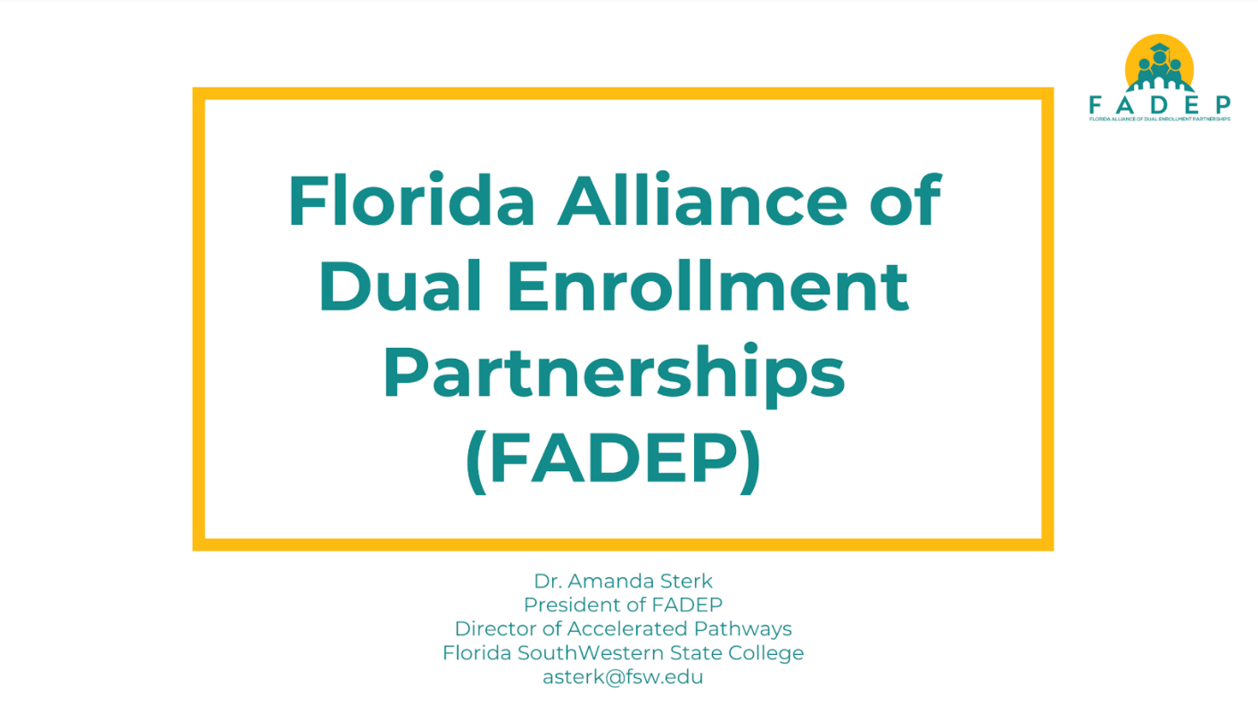

Slide 16
Build interest among programs
Recruit interim leadership
Recruit members and institutions
Formally adopt bylaws
Have voting members elect officers
Apply for official NACEP Chapter affiliation
Contact Dianne (dbarker@nacep.org) for assistance

Slide 17
Thank you! - Contact Information
Christine Denecker, Ohio Alliance of Dual Enrollment Partnerships (OADEP)
University of Findlay, denecker@findlay.edu
Beth Dorion, New England Alliance of Concurrent Enrollment Partnerships (NEACEP) Community College System of New Hampshire, bdoiron@ccsnh.edu
Mercedes Pour, New England Alliance of Concurrent Enrollment Partnerships (NEACEP), Maine Community College System, mpour@mccs.me.edu
Amanda Stark, Florida Alliance of Dual Enrollment Partnerships (FADEP)
Florida SouthWestern State College, amanda.sterk@fsw.edu
Dianne Lassai Barker, National Alliance of Concurrent Enrollment Partnerships (NACEP) dbarker@nacep.org

Slide 18
www.nacep.org/events/national-summit-for-dual-credit-programs/
2022 NACEP National Conferences
Minneapolis, MN
November 6 - 8, 2022
www.nacep.org/national-conference
NACEP Washington Policy Seminar
Washington, D.C.
April, 2022

Slide 19
THANK YOU from NACEP!
Dianne Lassai Barker
Director of State Engagement
National Alliance of Concurrent Enrollment Partnerships
dbarker@nacep.org

