Slide 1

From Spreadsheets to Spotlights:
Celebrating Success Through Data
Teresa Hernandez, CCP Director, Sinclair
Alicia Adams, CCP Assistant Director, Sinclair

Slide 2
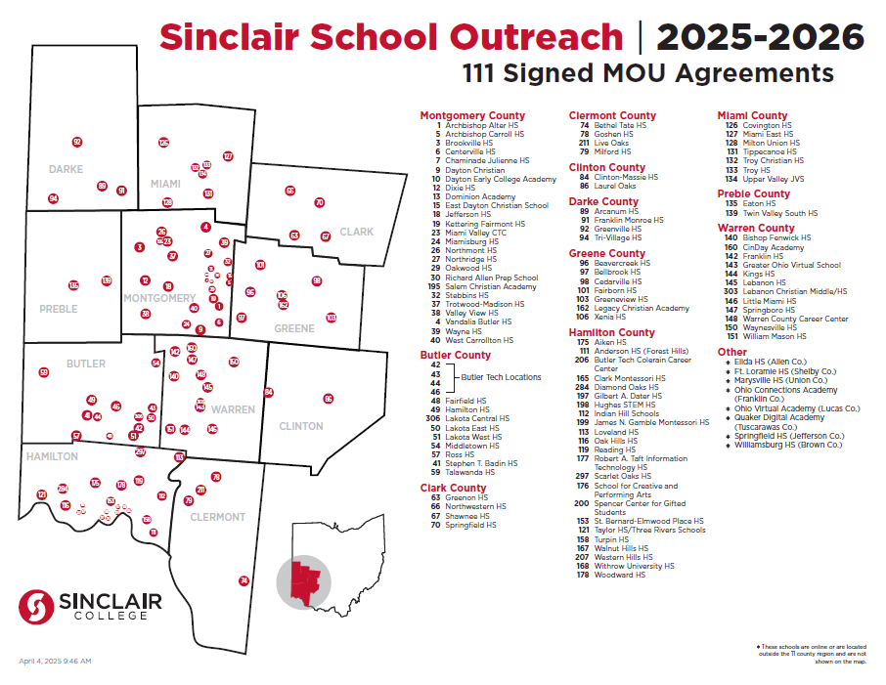
Who We Are
Over 157 high schools
74 high schools offering CCP Courses
11 County Region
Notes:
Review briefly who we are:
Started in 2015 – 16 AY when CCP begin
Started sending Fast Facts to schools at the end of the 2016-17 school year

Slide 3
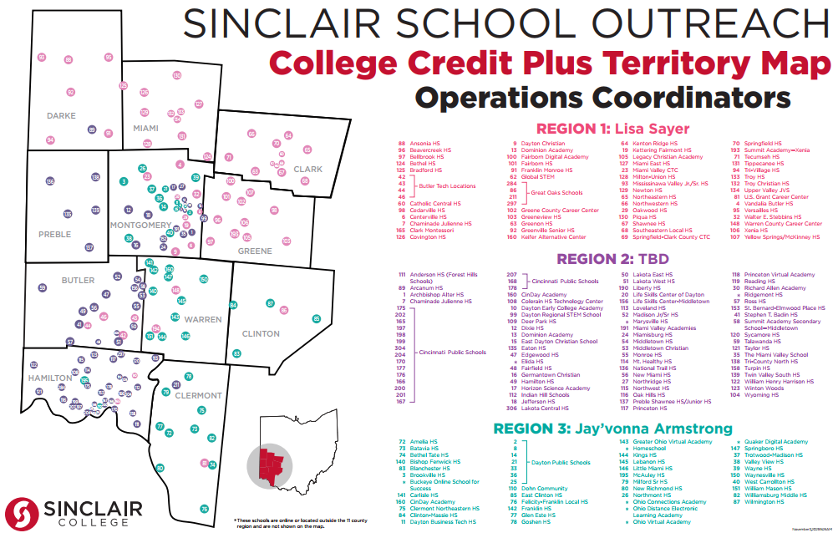
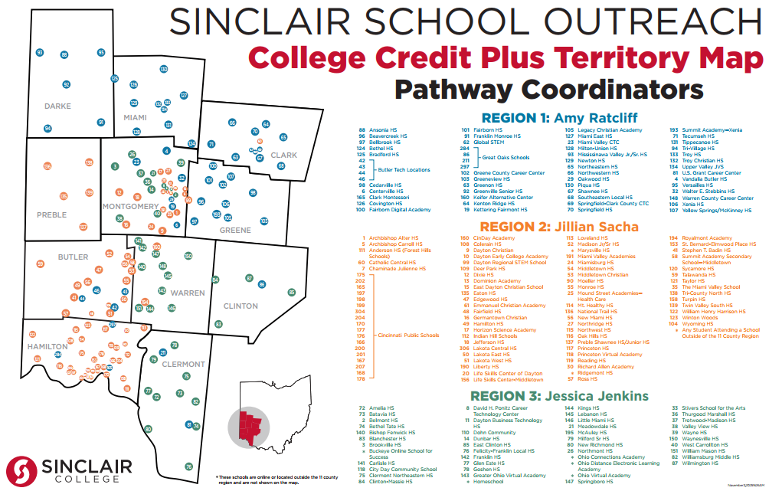
How Do We Do It?
1:1 Operations & Pathways Region Teams
Online High School Portal 24/7 Access
Strong communications with school partners, students and families

Slide 4
Why Storytelling With Data Matters
DATA WITHOUT CONTEXT CAN OVERWHELM OR DISENGAGE
BEHIND EVERY DATA POINT IS A STUDENT STORY
STORYTELLING BUILDS TRUST AND HIGHLIGHTS IMPACT

Slide 5



Our CCP Approach
COLLABORATION ACROSS DEPARTMENTS & HIGH SCHOOLS
MOVING FROM SPREADSHEETS TO SHARED INSIGHTS
BUILDING STRONGER PARTNERSHIPS THROUGH TRANSPARENCY

Slide 6
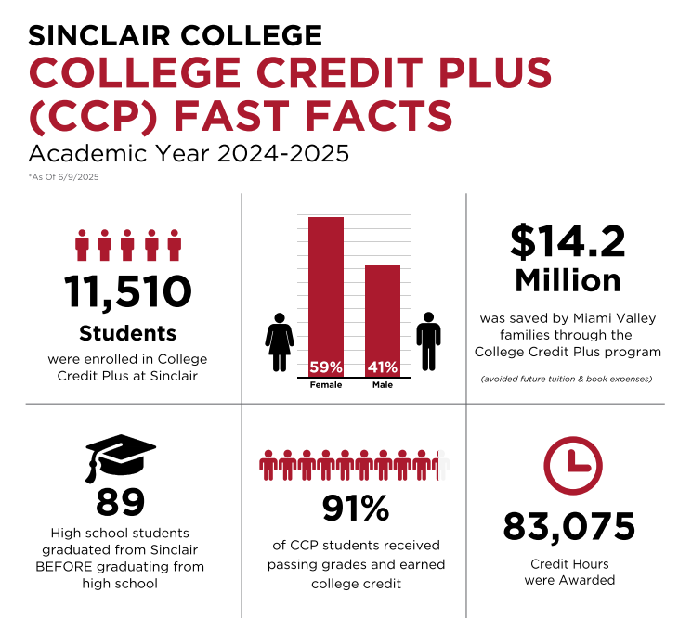

Slide 7
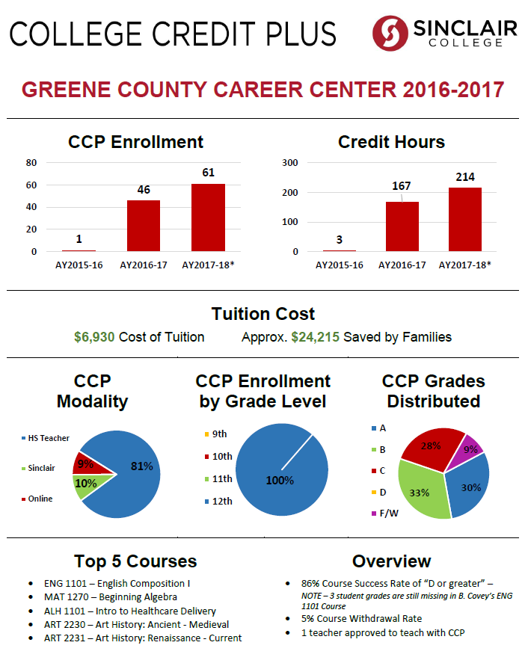
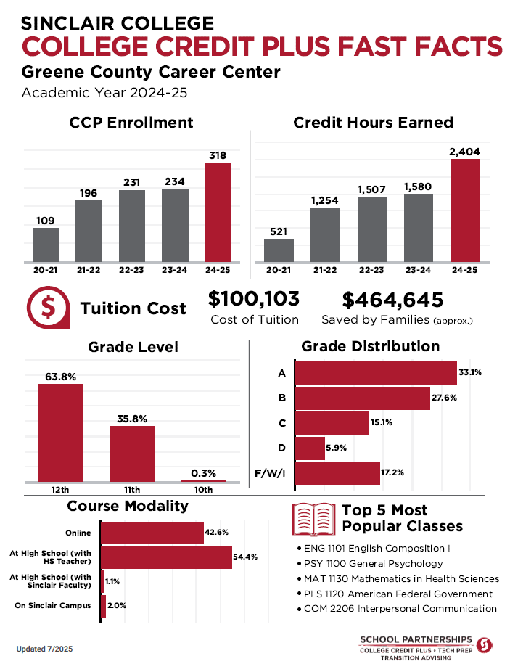
How We Did It
Focus on Collaboration
Shared Insights – find out what matters to them
Be Transparent!

Slide 8




From Data to Insights
1. Collect data – who has your data?
2. Clean & organize – use tools & programs to help fancy it up!
3. Translate into insights – what can you learn from the data?
4. Share stories with partners – help them to tell their stories to the community!
Notes:
Portal Data Access for community info to share / Share data with internal partners regarding enrollment and degree earners at various meetings and campus events

Slide 9
Turning Data Into Insights
Before: raw spreadsheets
After: clear charts & visuals
Framework: Track Translate Tell
Ask yourself: What dataset can I make more meaningful?

Slide 10




Key Takeaways
DATA IS RELATIONAL, NOT JUST INFORMATIONAL
STORIES MAKE NUMBERS MEMORABLE
SMALL WINS ADD UP
CELEBRATE COLLABORATION

Slide 11
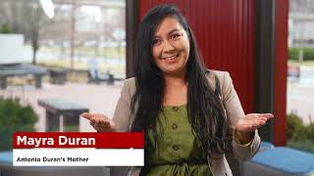

Slide 12

Questions???
Teresa Hernandez
Sinclair College
Teresa.hernandez@sinclair.edu
Alicia Adams
Sinclair College
Alicia.adams@sinclair.edu

