Slide 1

CCP Visits that Work!
Justin Hardman – Director, College Credit Plus
Brianna Albrecht – Assistant Director, College Credit Plus

Slide 2
Owens at a Glance

Slide 3


Owens Community College
Total Enrollment – Around 8000 students
Two locations:
Toledo Area Campus
Findlay Campus
CCP enrollment – Around 1800 students
Spread over 80 schools
Around 40 schools that have classes running in-building courses

Slide 4
CCP Department
Director
Assistant Director
Two Toledo Advisors
One Findlay Advisor

Slide 5
The Preparation & Visit

Slide 6
High School Outreach
Reach out to schools twice a year:
August – For Spring
March – For Fall
Emails sent out to schools
Dates are suggested based on staff calendars
Schools pick their top three times
Follow up to confirm date and number of students

Slide 7
Materials Sent
Sign-up Sheets
Have they taken classes before?
What major they are looking at
How many classes?
CCP Website with Level 1 Courses
CCP Application Bookmark
Mature Content Form

Slide 8
Office Prep
Looking at sign up sheet
Pre-check students for documentations/applications
Pre fill out reg forms
Make folders
Look at classes/majors to help with course availability
Confirm with school day/times

Slide 9
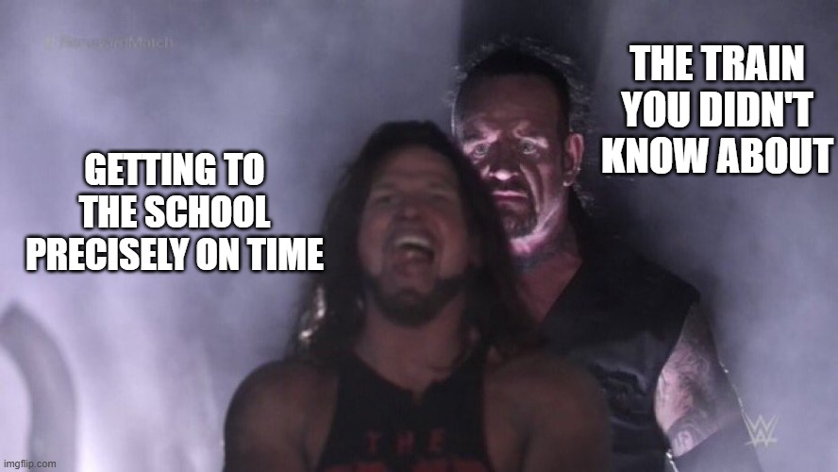
Day of Visit
Arrive early!
Meet up with teacher/counselor
Get set up and meet with students!

Slide 10
During the Appointment

Slide 11
The Appointment
We keep appointments to around fifteen minutes
Prep work shines here
Check in on any current classes
Look at next semester registration
Keep discussions somewhat high level
Suggest follow ups for more in-depth discussions
Transfer Pathways
Selective Health

Slide 12
The Follow-up
Send school the registration report
Detail any students with missing documentation
Encourage absent students to email the CCP Team
Have a debriefing on campus
What worked?
What didn’t work?
What feedback did we hear?
How to improve?

Slide 13
Results and Things to Think About

Slide 14
Results
We have seen a fairly significant increase in enrollment (for our size) and the number of visits.
For example:
October - November
2024 – 5 Visits – 378 Students
2025 – 12 Visits – 496 Students
Average of 16 more students per visit for the extra 7 visits.
More schools, more students, more engagement.

Slide 15


Benefits
Direct Engagement
Increased Visibility
Immediate Q&A
Visits are typically half days, so the other half is still used for work

Slide 16
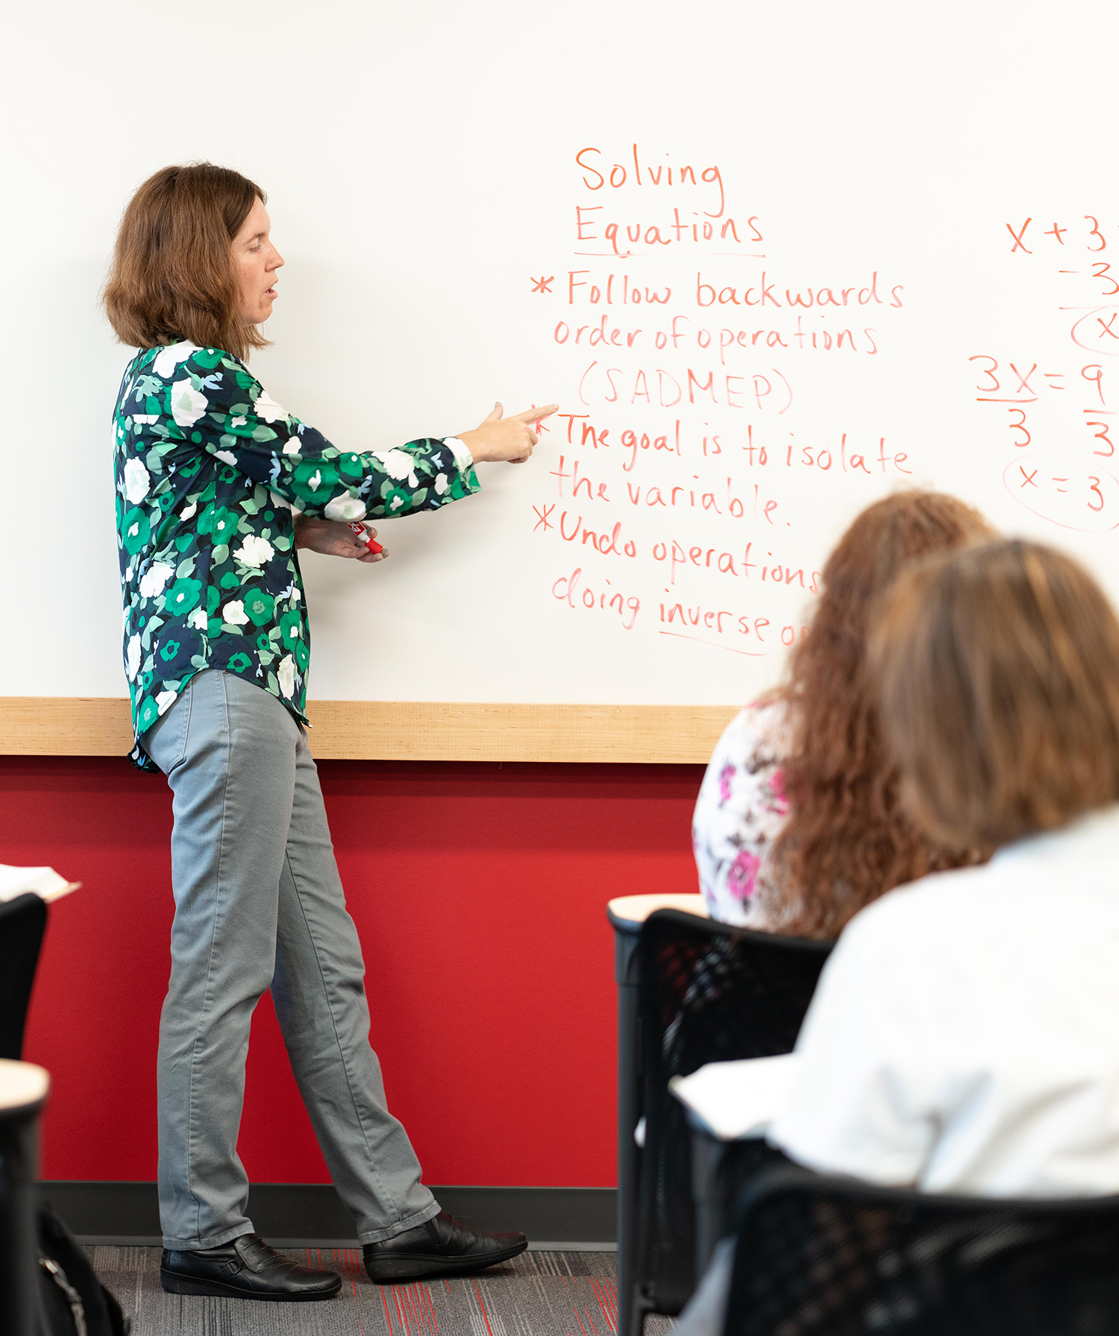
Things to Consider…
Time-Intensive
Finding the Right Balance
Follow ups

Slide 17
Q&A

